Slide 1

Only for you - relevant board game suggestions from BoardGameGeek.com
Sanni Isokirmo, Ahti Katiska, Miika Mäki

Slide 2
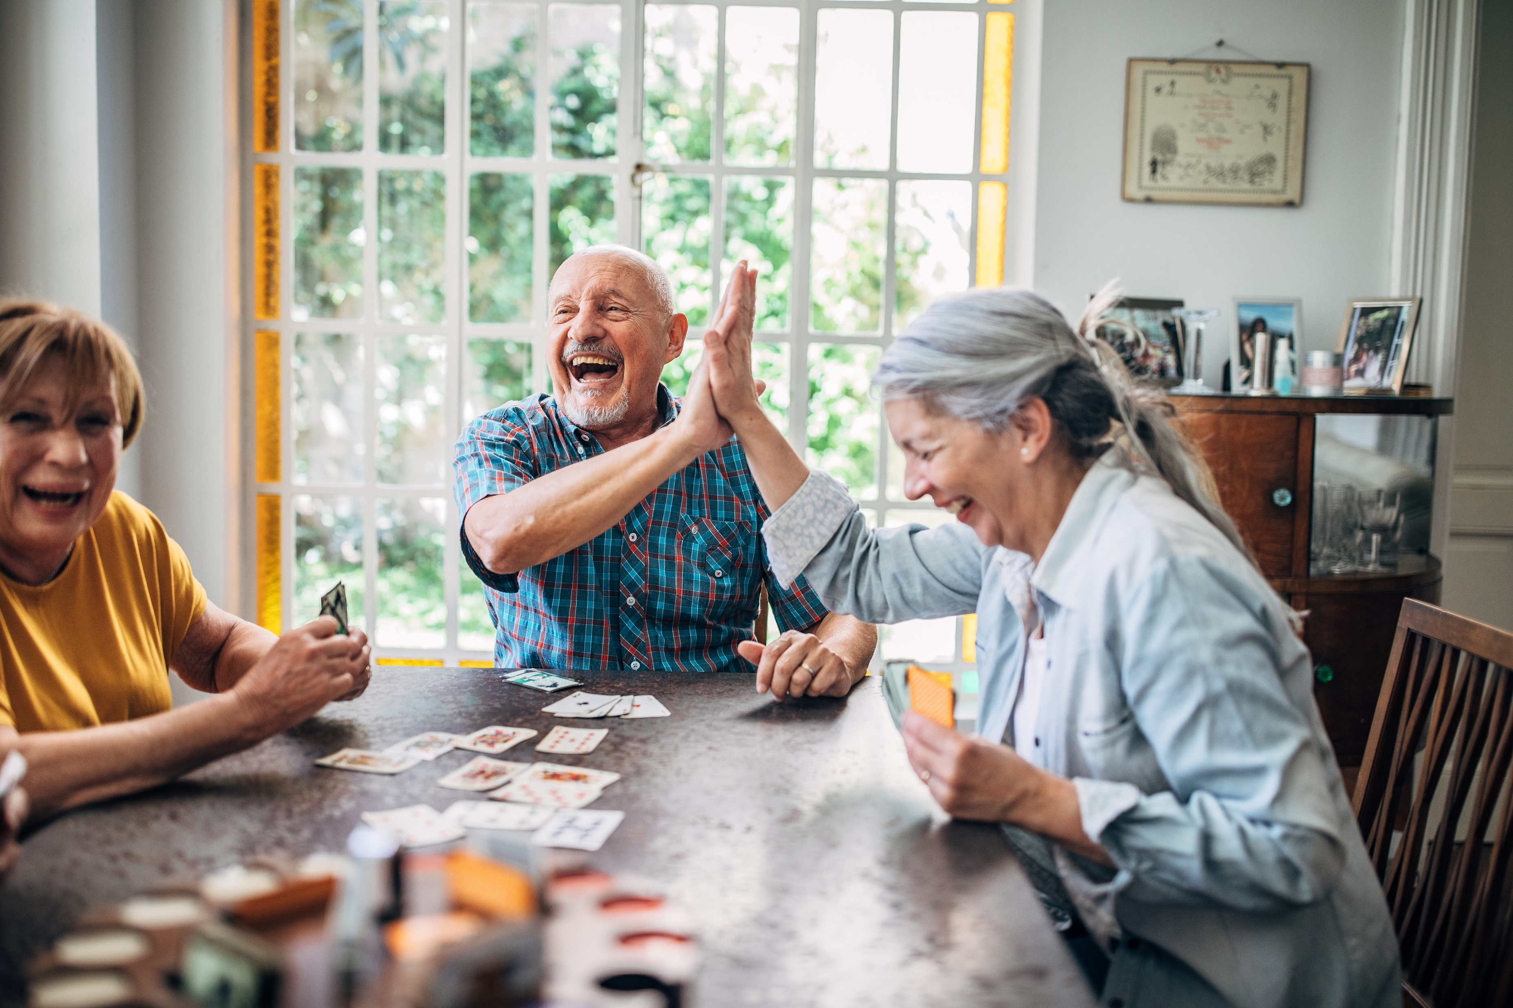

Slide 3


Slide 4


Slide 5


Slide 6

bit.ly/
board_game_geek

Slide 7
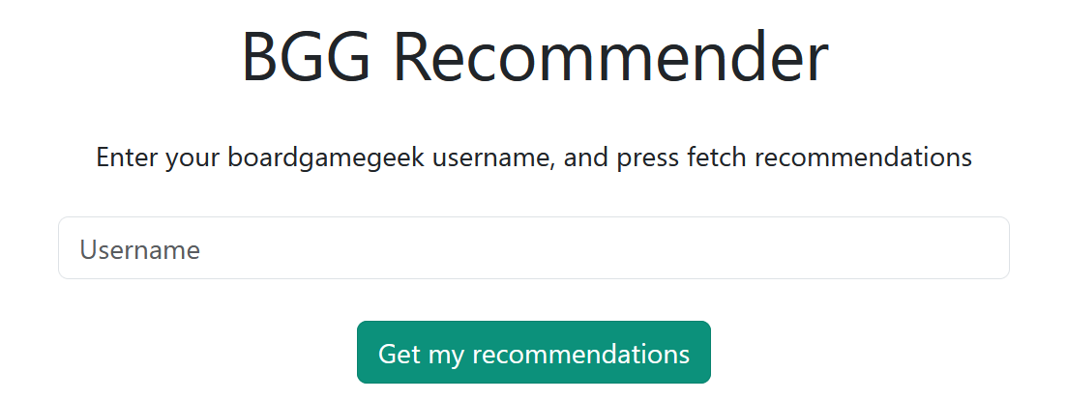


bit.ly/board_game_geek
AlexCast

Slide 8
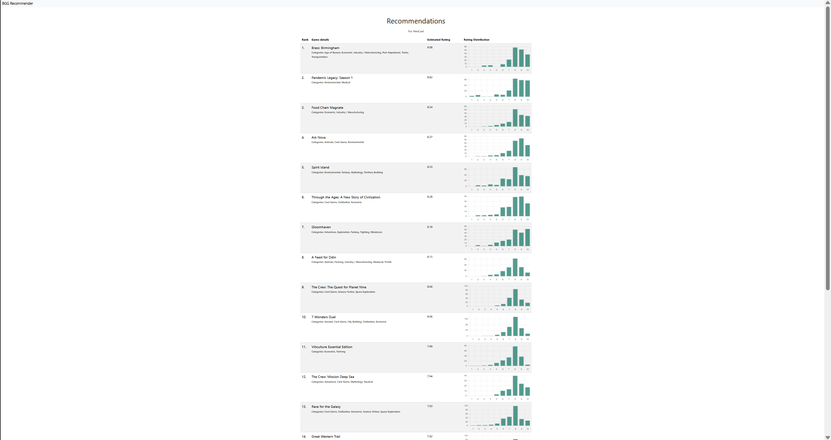
20
recommen-
dations

Slide 9
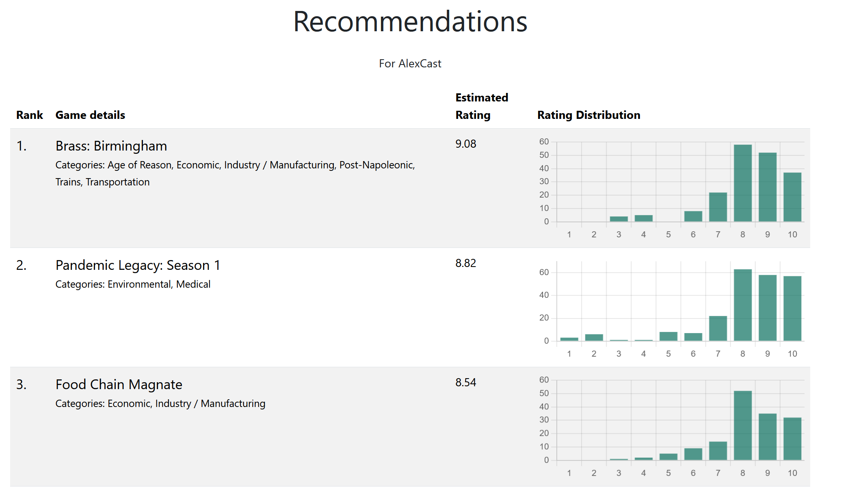



Slide 10






Slide 11
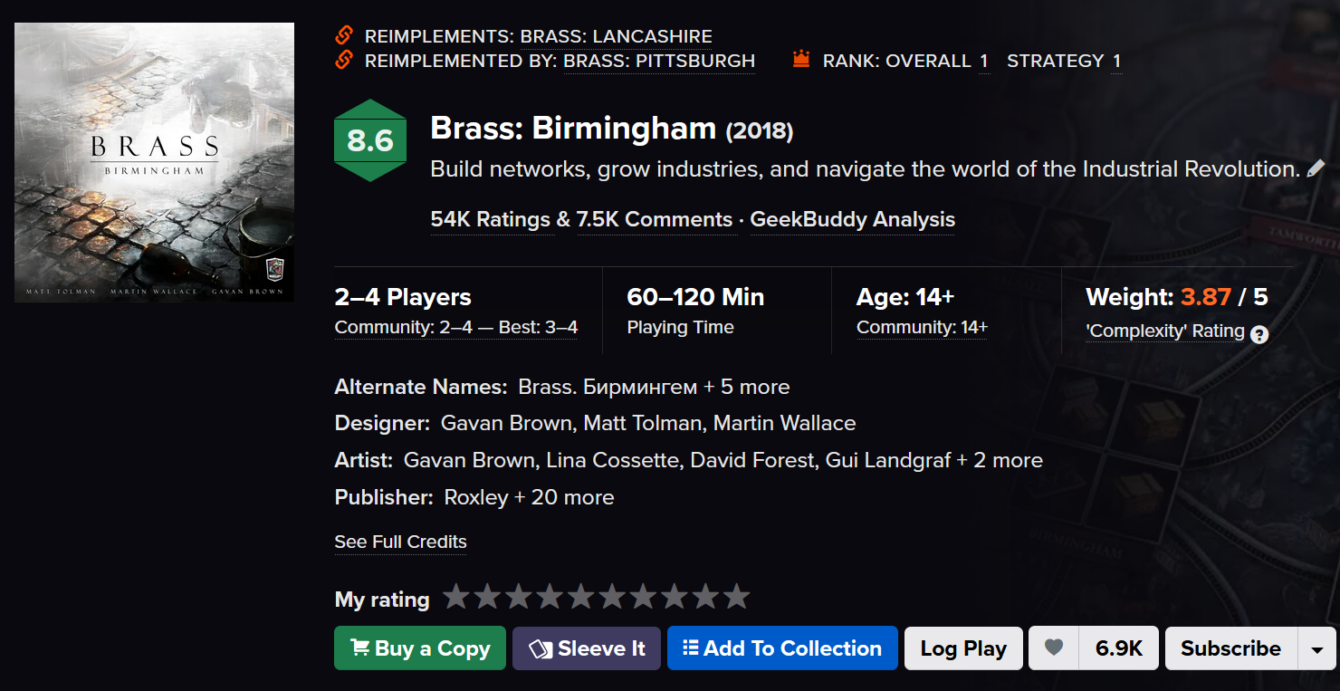

Slide 12

Notes:
Why this, you, know?

Slide 13

Game on! bit.ly/board_game_geek

